Slide 1

Money in Games
Exploring the relationship between Studios, Players, and Revenue
This Photo by Unknown author is licensed under CC BY-SA.

Slide 2

Gaming has evolved over time. Consoles have changed and now players can now interact through them to team play or continue to play solo. One might expect console gaming to be less prevalent with the introduction of online gaming, but instead the two both seem to maintain high popularity.
We explore the profitability of gaming by Studio, considering revenue, location and average number of players.
We initially started with a Kaggle data set that listed out games by studio as well as their revenue for 2000- 2017 among three regions, the US, Japan, and the EU.
We also scraped data from Steam charts to sort player information by game. We chose to express our data visualization with a global map that separates into those regions.

Slide 3
Coding Approach
Data Gathering/Munging
Web scraping – Steam player count
Data conversion
CSV & JSON to SQL
Backend
SqlLite Database
Flask
Input/Output
Python in, SQL out!
Notes:
Web scraping: we created a script that went over every single part of the first 100 games in steam and get the players amount since its introduction to steam. Created a json file that was going to modify

Slide 4
Coding Approach (cont.)
"Middle"
Filter, filter, filter!
Data routing
Frontend
React
D3
Leaflet
Plotly

Slide 5
Challenges
Serving Data
CORS
Formatting
Dependencies
Read: Bizarre Errors
React
Lifecycle

Slide 7
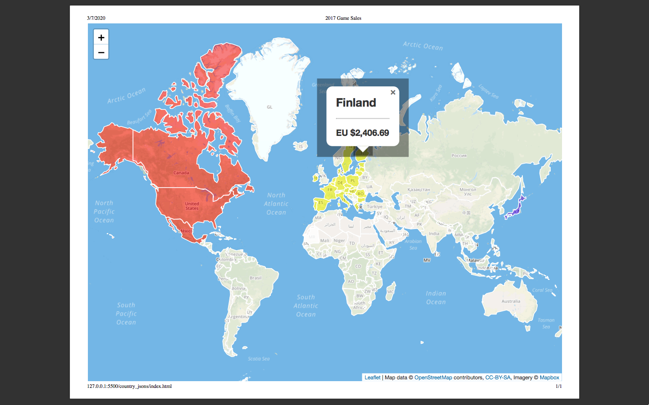

Slide 8
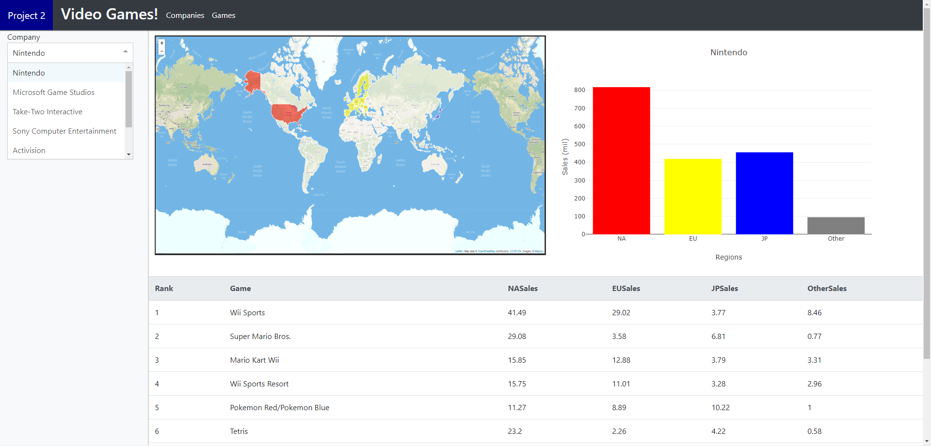

Slide 9
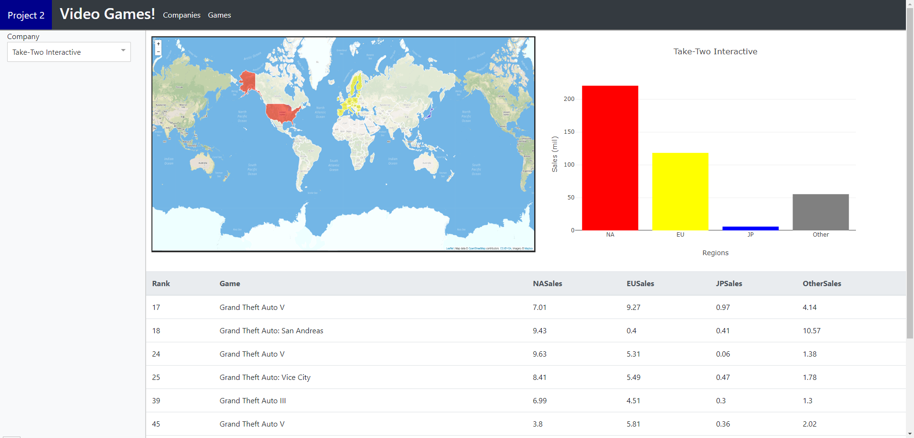

Slide 11
Biggest Esports prize pool
Counter strike (Total)
22.47M
Dota 2 (Total)
41.26M
Notes:
Hard to track earning, still a private company.

Slide 12
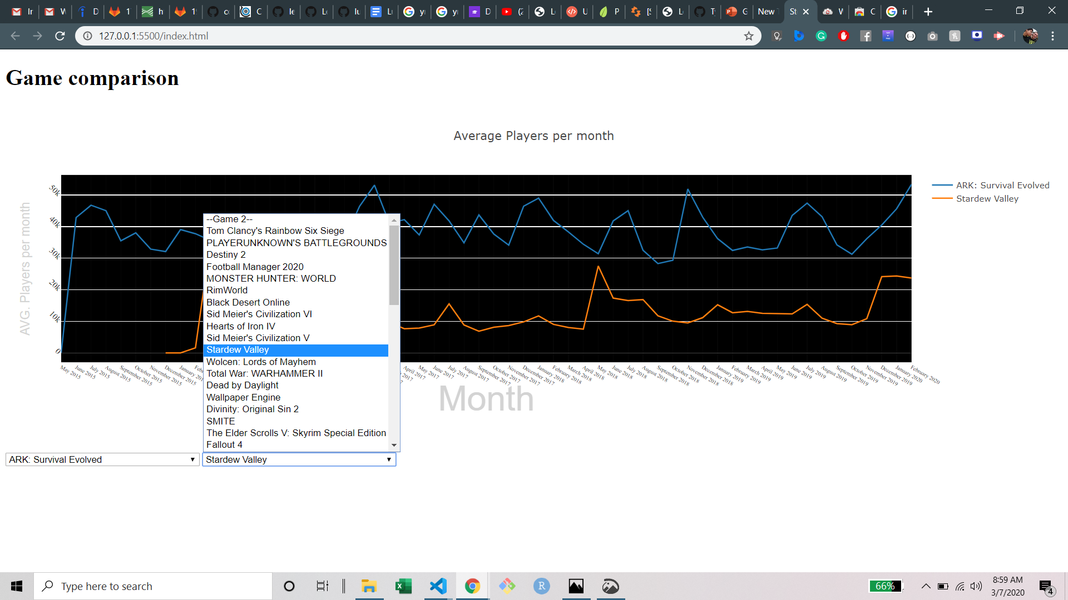
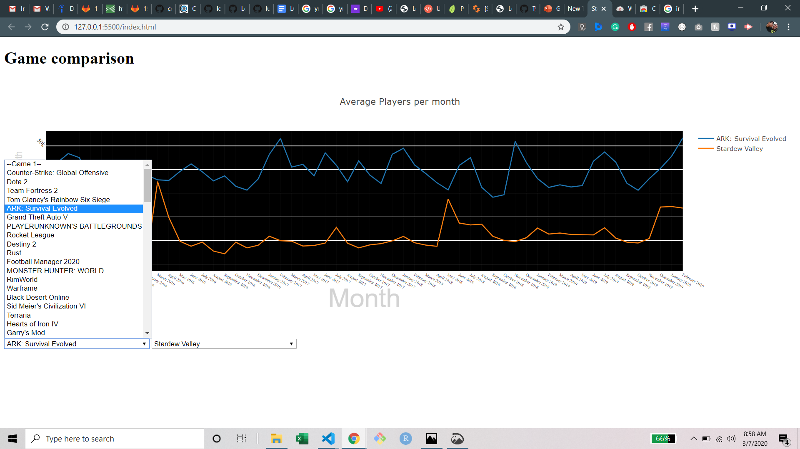

Slide 13

While we encountered unexpected challenges for this project, we were able to successfully explore the profitability of gaming.
This Photo by Unknown author is licensed under CC BY-SA-NC.

